Slide 1


Slide 2
Technical Note 2
Learning Curves

Slide 3
OBJECTIVES
Underlying Principles of Learning Curves
Learning Curve Example
Types of Learning
From Learning Curves to Performance Improvement
Notes:
2

Slide 4

Underlying Principles of Learning Curves
1. Each time you perform a task it takes less time than the last time you performed the same task
2. The extent of task time decreases over
time
3. The reduction in time will follow a
predictable pattern
Notes:
3

Slide 5
Example of a Learning Curve
Suppose you start a term paper typing business. You time yourself on the first paper, then the second, and so on.
Term paper
1
2
3
4
5
6
Time (in Minutes)
100
90
84.62
81.00
78.30
76.16
Note that only 90 of 100 minutes are used in the second repetition. This is an example of a 90% learning curve.
Notes:
4

Slide 6
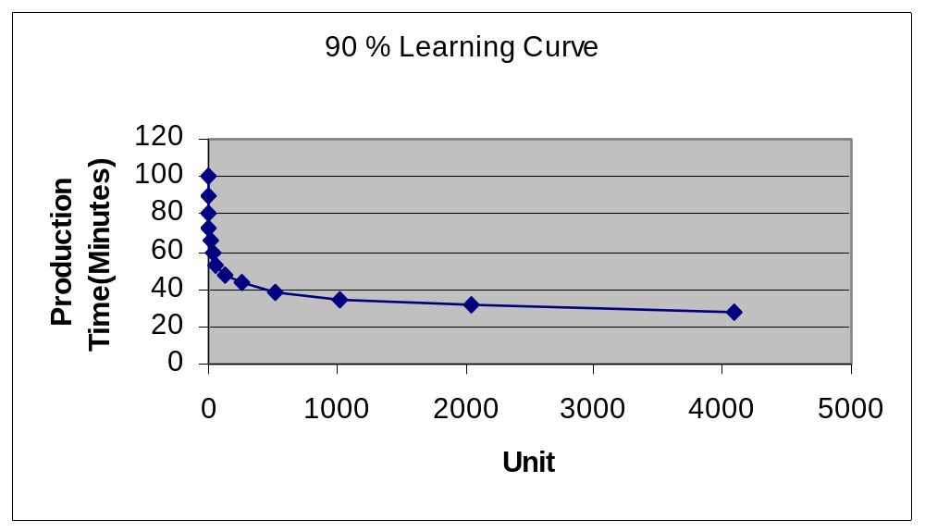
Plotting the
Learning Curve
All learning curves have this downward sloping curve.

Slide 7
Types of Learning
Individual Learning
Improvement when individuals gain a skill or efficiency by repetition of a job
Organizational Learning
Improvement from the groups of individuals from repetition and changes in administration, equipment, and product design
Notes:
6

Slide 8
From Learning Curves to Performance Improvement (Part 1)
Proper selection of workers
Proper training
Motivation
Work specialization
Do one or very few jobs at a time
Notes:
7

Slide 9
From Learning Curves to Performance Improvement (Part 2)
Use tools or equipment that assists or supports performance
Provide quick and easy access for help
Allow workers to help redesign their tasks
Notes:
7

Slide 10
End of Technical Note 2

